Slide 1
Causal-Temporal Identification of Markers Driving Fetal to Adult Kidney Transition
Proposed Project
By
Omid Sajjadi
Keck School of Medicine at USC
2025

Slide 2
What I need: 1- I need more fetal data, same age 2- I need more invitro data, same age 3- I need to talk to Max, explain method, get feedback 4- I need to present my methodologies to Jonathan/Zhongwei. 5- I need to implement my method to the data and Identify the markers driving maturity.

Slide 3
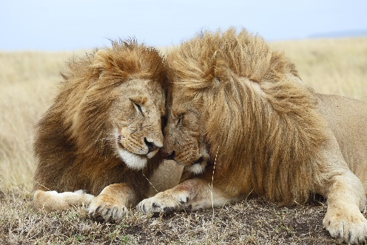
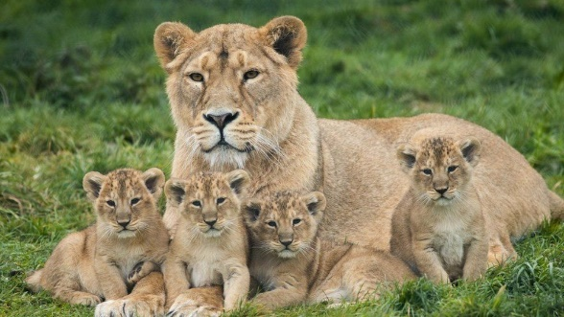
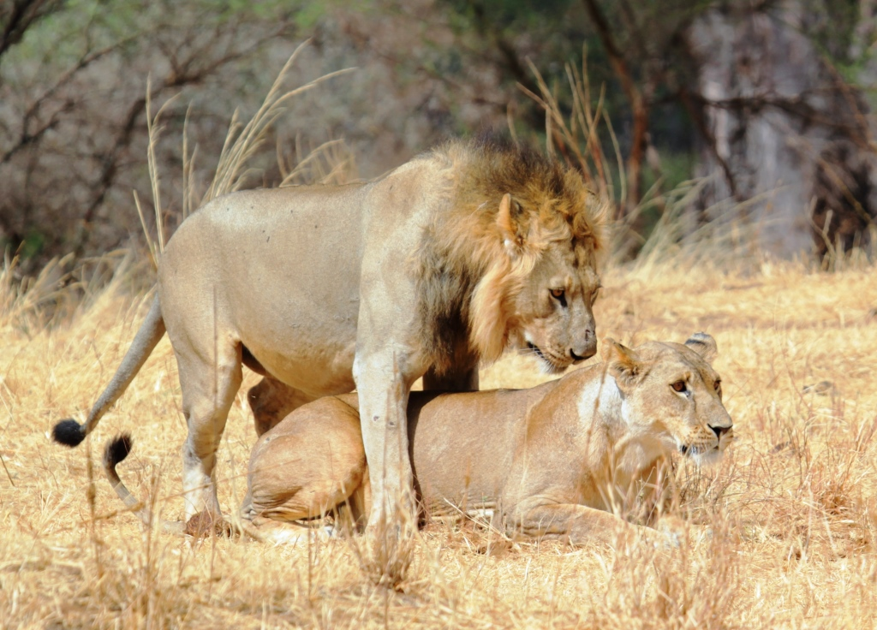
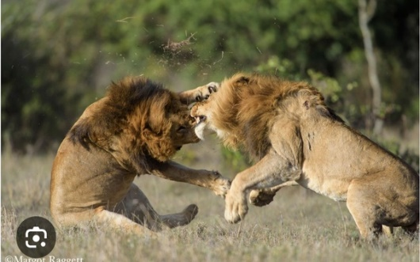
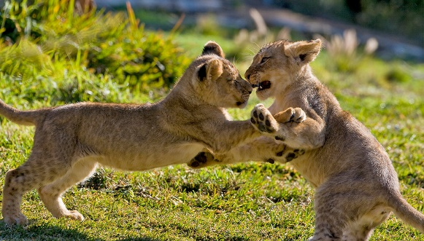
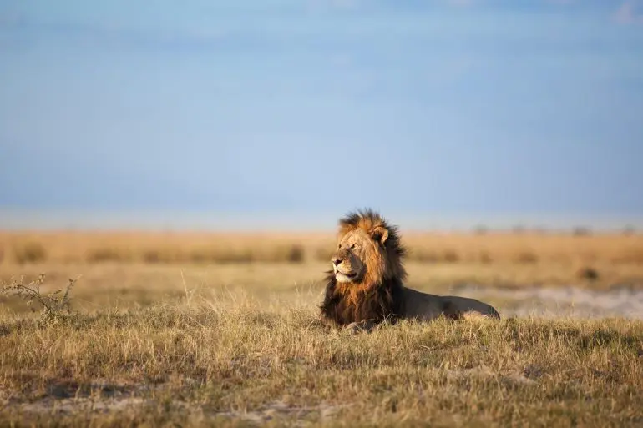
Social behavior is fundamental for survival
Affiliative
Parenting
Mating
Aggression
Play
Isolation
In Humans:
Strong social relationships improve physical health, mental health, and longevity.
Lack of social ‘connection’ is linked to heart disease, hypertension, depression, anxiety, and obesity.
Notes:
Dig deeper into topics

Slide 4
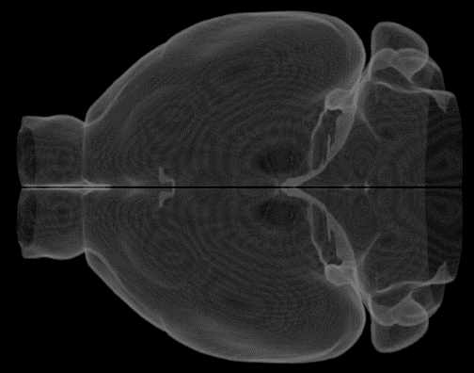
Social Behaviors Reflect Intersecting Factors
Affiliative
Parenting
Mating
Aggression
Play
Isolation
Sex, Age, Hormones
Context, Experience, Interoreceptive state…
Parenting
Affiliation
Reproduction
Aggression
Defense
Play
Endocrine
Social Stimulus
Notes:
We also know that
Social Behaviors Reflect all sorts of interesting variables about the underlying state.
The animal needs to take in all this information and make an adaptive choice for a social behavior.

Slide 5
The medial amygdala (MeA) mediates social behaviors
Sexual behavior: Lehman et al., 1980
Parenting: Numan et al., 1993
Social recognition: Ferguson et al., 2001
Grooming: Hong et al., 2014
Aggression: Unger et al., 2015
Discrimination: Yao et al., 2018
Affiliative touch: Wu et al., 2021
Social Buffering: Hong et al., 2022
SBN
BST
MeA
LS
POA
Mid
AH
VMH
Notes:
We focus on the MeA because it has now been associated with, essentially, all social behaviors that have been studied in mice.

Slide 6
The Role of Oxytocin in the MeA
Social interactions → Oxytocin release → Emotional buffering
Oxytocin modulates MeA responses to threats
Shifts behavior from defensive → affiliative
Real systems (brains) = nonlinear, dynamic

Slide 7

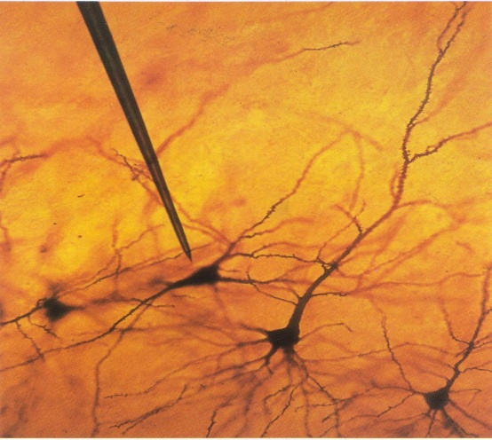
How do we Understand a Neural Circuit?
Present a stimulus – measure response
Correlation
Measure neural activity – measure behavior
Notes:
The below one is not mere correlation and is the closest we have to caussation
But what is a neural circuit, or network?
-Starting broad, its important to look at some of the ways neuroscience has generally progressed.
Usually when we want to understand a circuits function we do one of two things:
-One, present a stimulus and record the response
-Two, manipulate the circuit and measure the behavior
Both of these approaches implicate a model in where you have sensory input, neural processing, then behavioral output.

Slide 8
Predictive Power?
Past
Fetal
Markers
Future
Fetal
Markers
Past
Adult
Markers
Future
Adult
Markers
These assumptions often fail in biology (Fails in brain-behavior dynamics)
Granger causality
Linearity
Fixed lags
Stationarity (stable behavior over time)

Slide 9
Predictive Power?
Past
Neural
Activity
Future
Neural
Activity
How much are predictions improved?
Past
Social
Behavior
Future
Social
Behavior
These assumptions often fail in biology (Fails in brain-behavior dynamics)
Granger causality
Linearity
Fixed lags
Stationarity (stable behavior over time)

Slide 10
Predictive Power?
Past
Neural
Activity
Future
Neural
Activity
Motor
Past
Social
Behavior
Sensory
Future
Social
Behavior
These assumptions often fail in biology (Fails in brain-behavior dynamics)
Granger causality
Linearity
Fixed lags
Stationarity (stable behavior over time)

Slide 11
Predictive Power?
Past
Neural
Activity
Future
Neural
Activity
Fiber
Photometry
Sensory
Past
Social
Behavior
Motor
Future
Social
Behavior
Behavioral Features (PCA)
These assumptions often fail in biology (Fails in brain-behavior dynamics)
Granger causality
Linearity
Fixed lags
Stationarity (stable behavior over time)
Notes:
The neurons effecting the world is sensory and the world effecting the neurons is motor

Slide 12
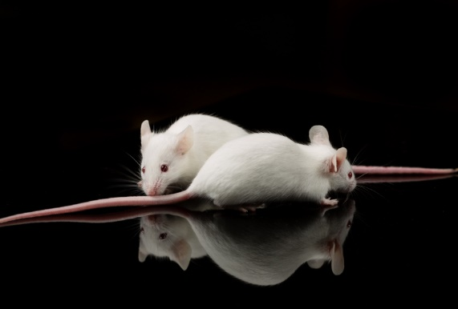
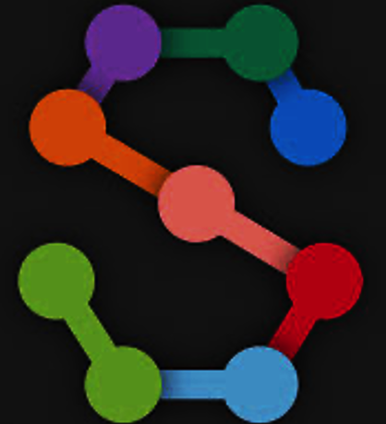
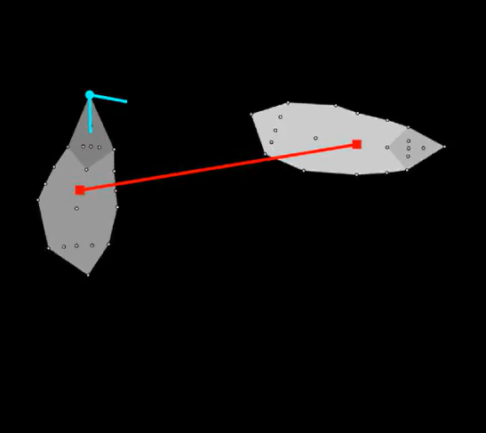
Approach for Automated Social Behavior Analysis
Notes:
-Highlight goal,
-We want an unsupervised approach for representing the social interactions in a video.
There is a lot of different ways of doing this. The reason we settled on the way we did is for a few reasons.
1: We wanted it to be discovery driven.
2: We wanted to be able to use both a continuous and discrete representation of behavior.
3: We didn't want to make any assumptions about the timescale of behavior. This will all make more more sense after I walk... you through the four steps we took to do that.

Slide 13
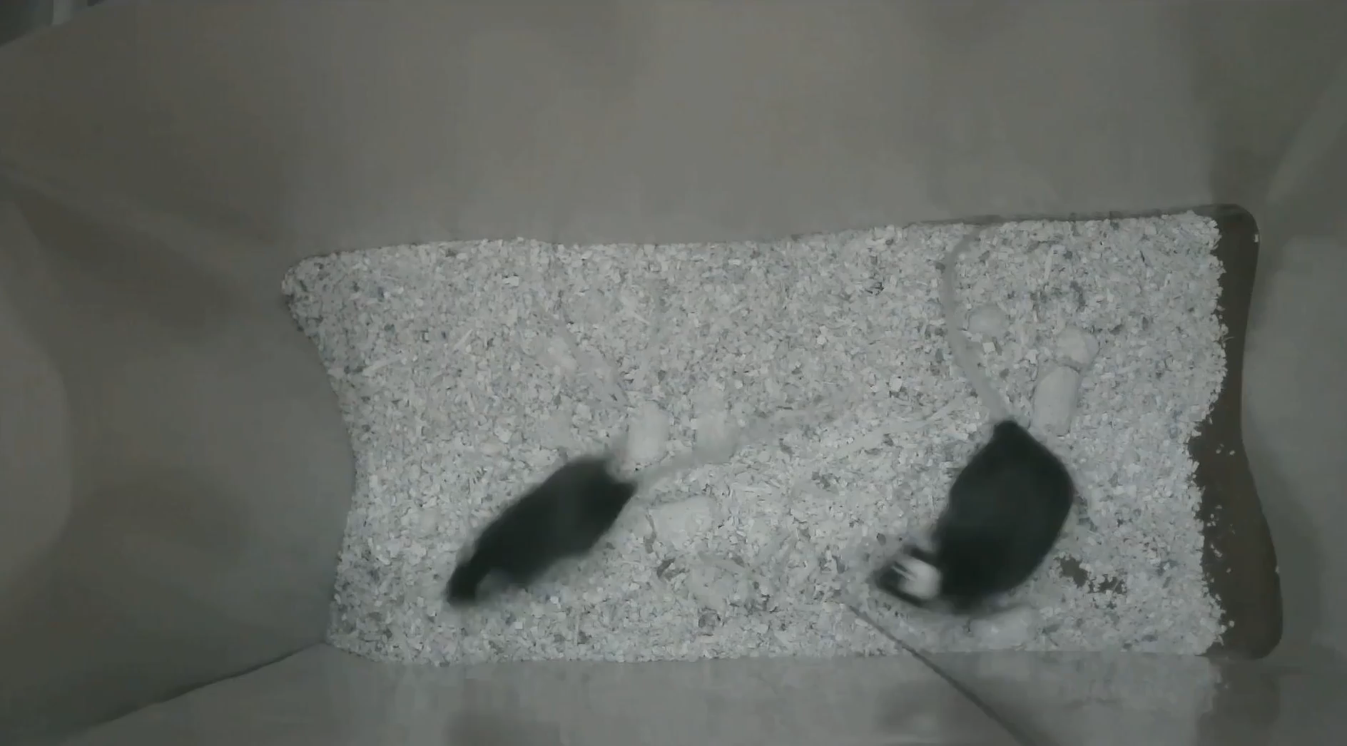
Markerless Labeling with SLEAP
Pereira et al., 2022
Notes:
Introduce Resident Intruder
-All of this is in the context of a resident intruder paradigm.
-You take a mouse in its home cage and introduce an age-matched intruder. For us, the variable we manipulate here is the sex of the intruder.
Important points. The points are not there previously,
We train a model to do this using our skeleton (talk about skeleton, robust… lots of points)
Outputs exist in pixel space, independent of the original videos.
(allows us to treat them as essentially mathematical objects)

Slide 14
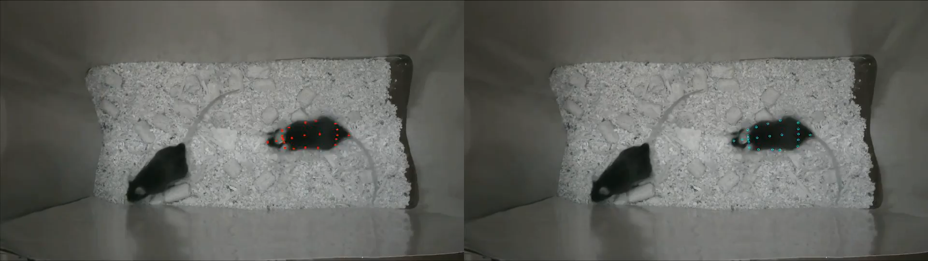
Autoencoder (Refinement through Bottleneck)
Input
(x,y)
Dense
Layer
Time
Convolution
Bottle-
neck
Dense
Layer
Output
(x,y)
44 nodes
128
64
64
44
16
Frames
Series
Notes:
The idea is that by training a neural network to have to condense the information to a low-D space it has to learn the compositional structure and is thus able to impute missing points are
By using a convolutional layer, we also constrain where the points are able to be and thus smooth over the jitter.
*There have been other recent advancements in this area that use a transformer-based architecture, but this works for us!
Now play video,
Bottleneck, how does it work expalin more on autoencoder part

Slide 15
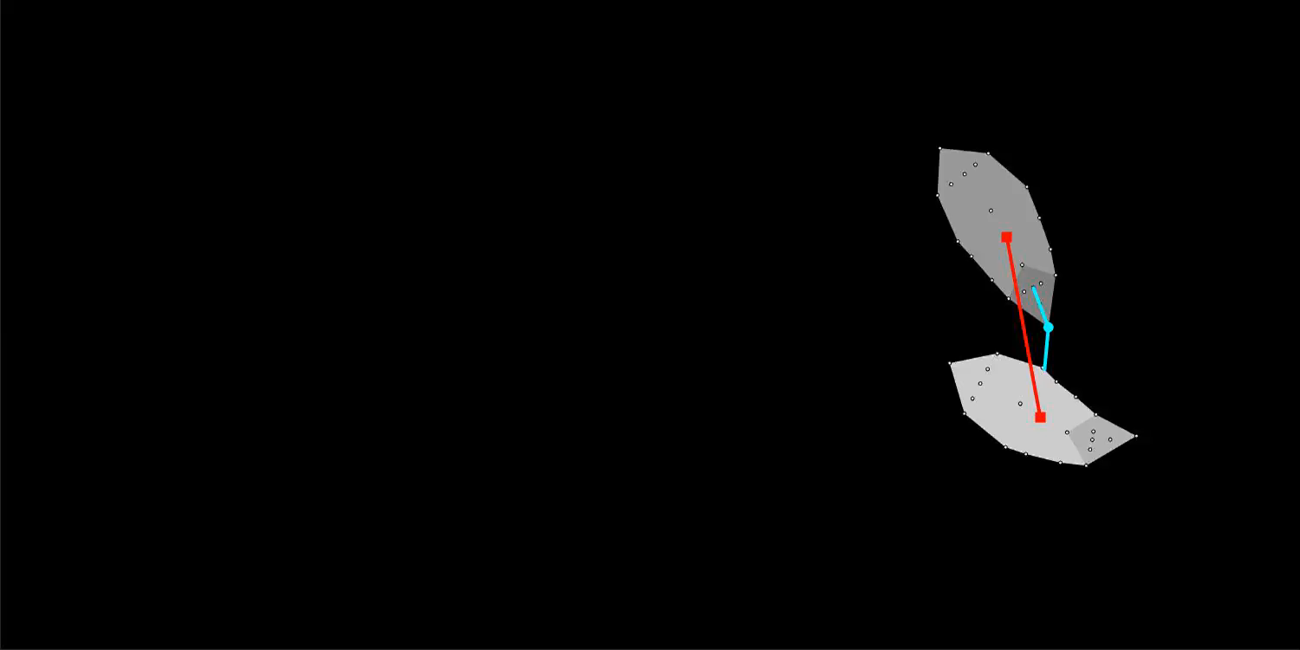
Extraction of Features Underlying Behavior - PCA
23 Distances
20 Angles
Notes:
So lets move closer to that by computing features which in some way indicate behavior. We can look at two examples here. Think about it, we are trying to get at beh, if two mice are sniffing each other their noses need to be close. So we compute the nose to nose distance. We compute a whole bunch of these.

Slide 16
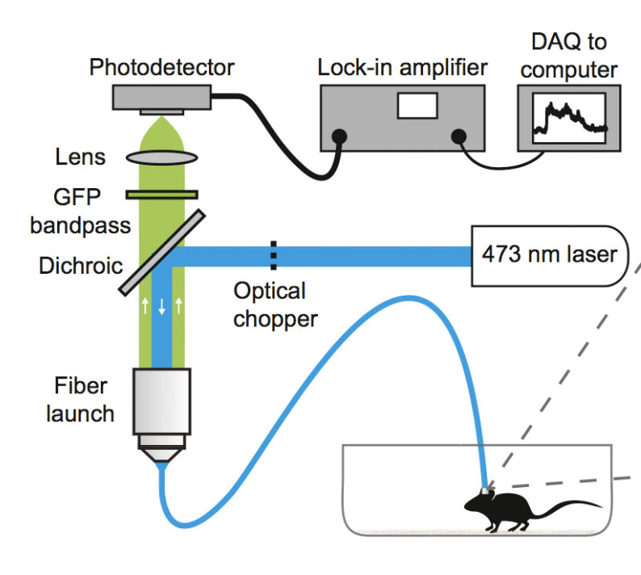
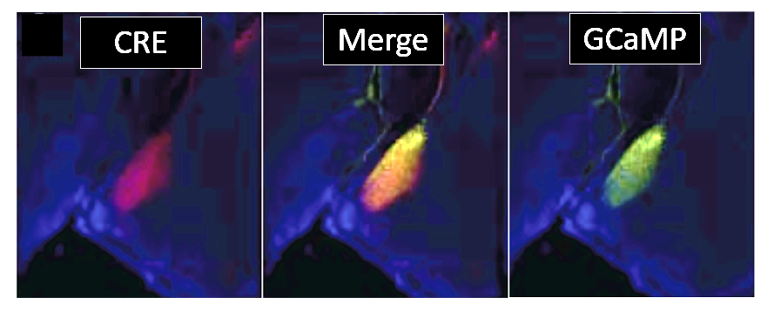
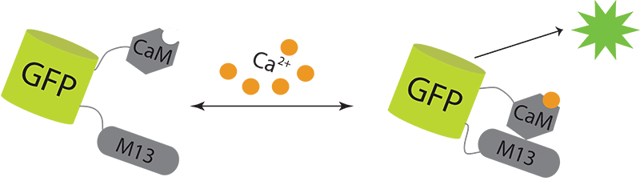
Accessing the Moment-to-Moment Activity of Arom+ Neurons
AAV-FLEX-GCaMP6s
MeA
Arom⁺
Notes:
Same method but with the BNST/eralpha
-Only difference is ESR1 is a knockin, cre expressed from endogenous locus…
-Good for faithful expression
-Bad because it slightly interfers with endogenous esr1
As opposed to bacterial ac which just adds a huge chunk of dna… It means regulatory elements are different

Slide 17
Predictive Power?
Past
Neural
Activity
Future
Neural
Activity
Fiber
Photometry
Sensory
Past
Social
Behavior
Motor
Future
Social
Behavior
Behavioral Features (PCA)
These assumptions often fail in biology (Fails in brain-behavior dynamics)
Granger causality
Linearity
Fixed lags
Stationarity (stable behavior over time)

Slide 18
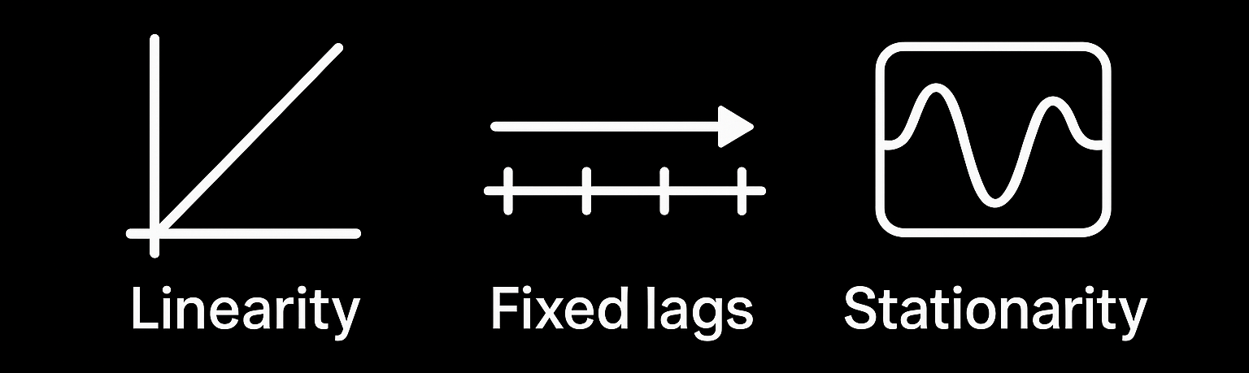
Granger Causality
These assumptions often fail in biology (Fails in brain-behavior dynamics)
Need for New Methods
Behavior patterns shift over time → Need dynamic models
Notes:
Stationarity here refers to stable behavior over time (assumption)
Linearity
What it means: Granger causality assumes a linear relationship between the time series. That is, it models the influence of one variable on another using a linear regression framework.
Why it matters: If the true causal relationship is nonlinear, Granger causality may fail to detect it (i.e., false negative), or it might detect a spurious effect if nonlinearity is misrepresented as linear influence.

Slide 19
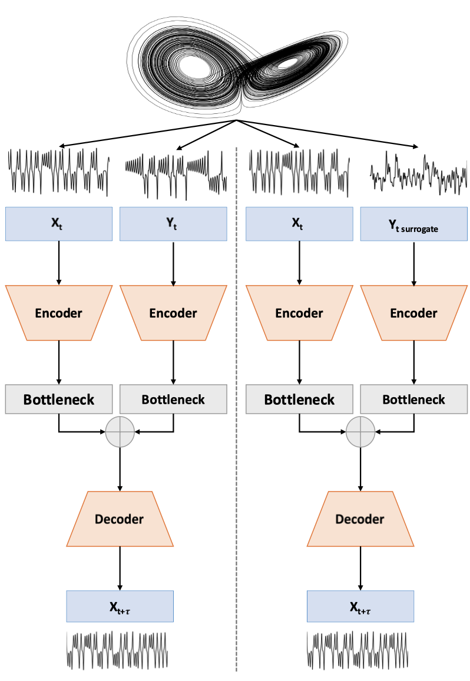
Two-headed predictive autoencoder that predicts the future of one variable (X) from the past of X and Y and another that predicts the future of X from the pasts of X and a randomized version of Y
Temporal Autoencoders for Causal Inference
Josuan Calderon & Gordon Berman, 2024
It learns the causal structure directly from temporal patterns in real signals — unlike Granger, which imposes strong assumptions that often don’t hold in neuroscience.
Notes:
Imagine your behavioral signal shows a sharp increase only after MeA activity crosses a certain threshold and sustains it for a few frames. Granger causality will miss this nonlinear, conditional dependency.
TACI, through deep representation learning, can implicitly learn this thresholded and time-delayed rule.
If timing is import if we shuffle the meaning still has prestn.
Recently Josan and Gordon came out with a method for doing exactly this! So we'll be using this technique to measure causality in our data.
They made contributions which we'll be using...
An architecture for the model and a metric for explicityly measuring one's gain predictive power.
The machine learning method is composed of two different networks: one takes in the pasts of X and Y and tries to predict the future of Y, and the other takes in the past of Y and a shuffled version of X and tries to predict the future of Y. If the network that has the real time series of X does better, we say that it’s an interaction
We then test the other way (replace all the Xs with Ys and Ys with Xs in the above sentence), and this tells us is both are interacting with each other, one with the other, neither, and the relative strength of the interactions
I can give details on the neural network if useful, but I figured that it wouldn’t be worth going into in this short of a talk, and I will be there if people have questions
We’ve shown that it works on a variety of systems with known answers, including one on the next page

Slide 20
TACI Optimization Process
TACI Optimization
MeA Fiber Data
Sweep A
Surrogate Data
Behavior Features (PCA)
Sweep B
Fiber Photometry: Neural Recordings
Real-time MeA calcium activity
Neural signal synchronized to behavior
Extraction of Features Underlying Behavior
Reduces pose data to main components
PC1 = dominant movement pattern (behavioral axis)

Slide 21
TACI Optimization Process
TACI Optimization
MeA Fiber Data
Sweep A
Surrogate Data
Behavior Features (PCA)
Sweep B
Fiber Photometry: Neural Recordings
Real-time MeA calcium activity
Neural signal synchronized to behavior
Extraction of Features Underlying Behavior
Reduces pose data to main components
PC1 = dominant movement pattern (behavioral axis)

Slide 22
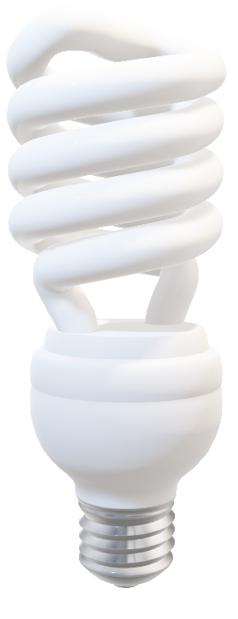
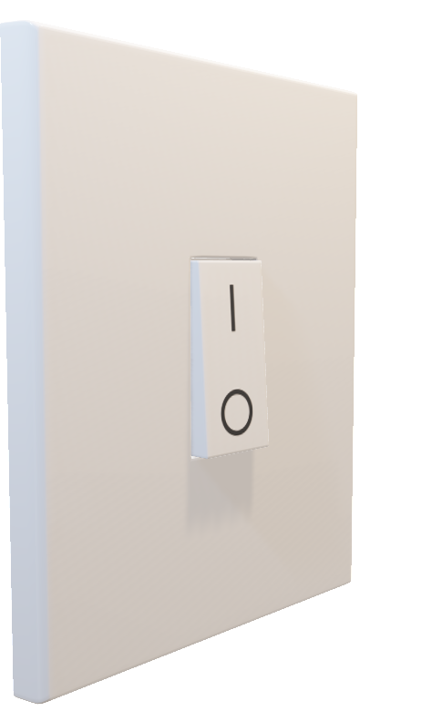
Timing Matters
Flip switch on
(cause)
Light turn on
(effect)
Fiber Photometry: Neural Recordings
Real-time MeA calcium activity
Neural signal synchronized to behavior
Extraction of Features Underlying Behavior
Reduces pose data to main components
PC1 = dominant movement pattern (behavioral axis)

Slide 23
The cause-effect relationship disappears
Flip switch off
Light turns on
So, if something truly causes something else, breaking the timing should destroy the cause-effect relationship
Fiber Photometry: Neural Recordings
Real-time MeA calcium activity
Neural signal synchronized to behavior
Extraction of Features Underlying Behavior
Reduces pose data to main components
PC1 = dominant movement pattern (behavioral axis)

Slide 24
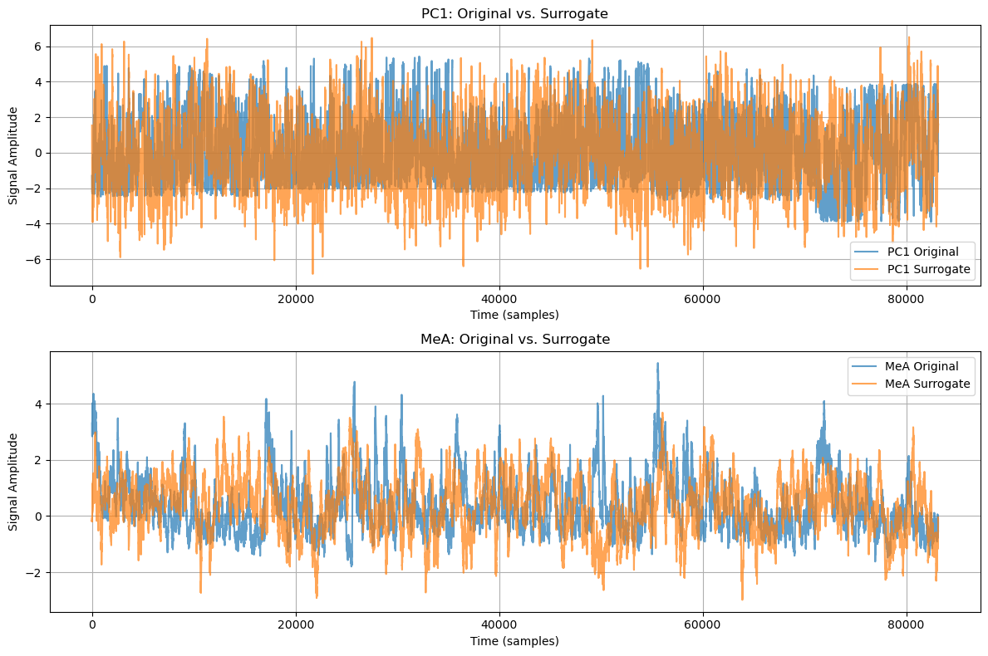
Surrogate Data
We use surrogate data to test if the timing really matters.
We shuffle the data, this removes temporal relationship (no cause-effect), Then we run our model on this surrogate data. If our model still finds causality on this data, probably false causality
Notes:
The power spectrum shows how much energy a signal has at different frequencies, like a graph that tells you which "pitches" are loud or quiet in a sound. To make sure our fake (surrogate) signals were good copies of the real ones, we used a math tool called the Fast Fourier Transform (FFT) to create the power spectrum for both. We checked if they looked similar, focusing on the positive frequencies. Since the graphs matched closely (shown in Figure 4), it proved our fake signals were accurate and could be used for comparisons
Power Spectrum: Shows how a signal's energy is distributed across different frequencies, like a graph of "loudness" for each pitch
Validation Process: Used Fast Fourier Transform (FFT) to compare power spectra of original and surrogate signals, ensuring fake signals match real ones
Results: Close match in power spectra (Figure 4) confirms surrogates preserve frequency distribution, making them reliable for comparisons.

Slide 25
TACI Training
Behavior
Encoder
Bottleneck
Decoder
Future Behavior Prediction
Train 4 TACI models:
x and y→y
xsurr and y→y
y and x→x
ysurr and x→x
Neural Activity
Encoder
Bottleneck
Behavior
Encoder
Bottleneck
Decoder
Future Behavior Prediction
Neural Activity
Surrogate
Encoder
Bottleneck

Slide 26
Here show an example of the model
Cause Signal
Encoder
Bottleneck
Decoder
Future Signal Prediction
Effect Behavior
Encoder
Bottleneck
Train 4 TACI models
x and y→y,
xsurr and y→y,
y and x→x, \
ysurr and x→x)

Slide 27
TACI Output and CSGI
A series of predictions of x or y
Compared across original vs surrogate models
Yielding CSGI values that quantify directional causal influence over time
CSGI = R²_real - R²_surr
CSGI is the causal strength score
R² (variance explained)
CSGI is high when the model needs real x(t)’s timing to predict y(t).
CSGI is low when surrogate x(t) works just as well — no real causal timing.

Slide 28
TACI Optimization Process
TACI Optimization
MeA Fiber Data
Sweep A
Surrogate Data
Behavior Features (PCA)
Sweep B
Fiber Photometry: Neural Recordings
Real-time MeA calcium activity
Neural signal synchronized to behavior
Extraction of Features Underlying Behavior
Reduces pose data to main components
PC1 = dominant movement pattern (behavioral axis)

Slide 29
TACI Optimization Process
TACI Optimization
MeA Fiber Data
Sweep A
Surrogate Data
Behavior Features (PCA)
Sweep B
Fiber Photometry: Neural Recordings
Real-time MeA calcium activity
Neural signal synchronized to behavior
Extraction of Features Underlying Behavior
Reduces pose data to main components
PC1 = dominant movement pattern (behavioral axis)

Slide 30
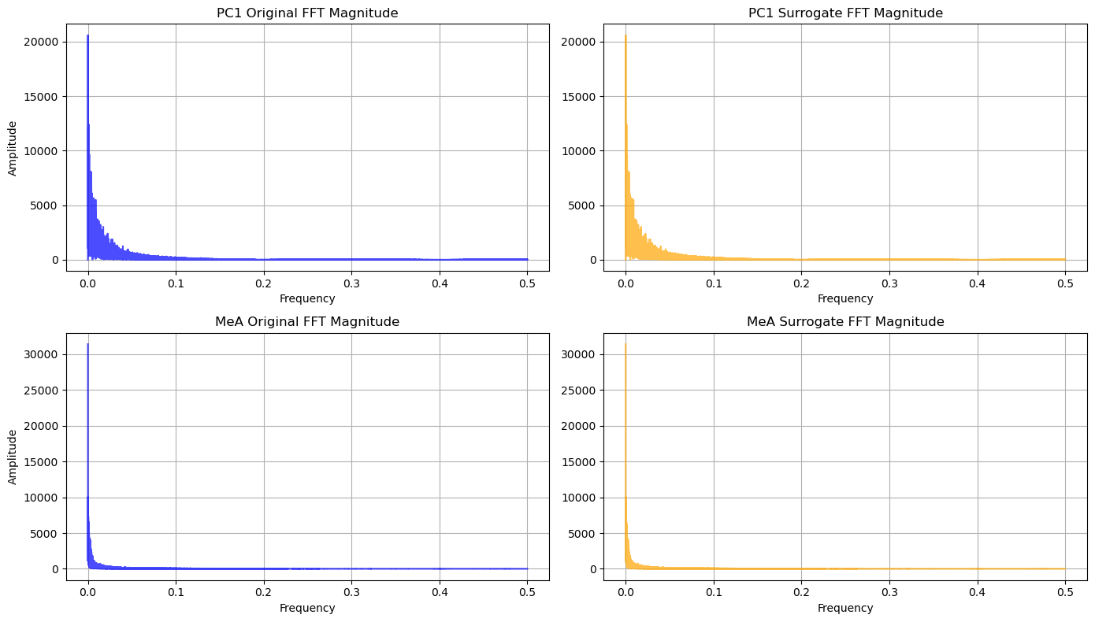
Surrogate Data
We must shuffle data while keeping frequency same, this will make our surrogate data
If data timing is important and has meaning shuffling the data shouldn’t remove the menaing that’s why we make the surrogate data
Tests if causality is real, not random
Notes:
The power spectrum shows how much energy a signal has at different frequencies, like a graph that tells you which "pitches" are loud or quiet in a sound. To make sure our fake (surrogate) signals were good copies of the real ones, we used a math tool called the Fast Fourier Transform (FFT) to create the power spectrum for both. We checked if they looked similar, focusing on the positive frequencies. Since the graphs matched closely (shown in Figure 4), it proved our fake signals were accurate and could be used for comparisons
Power Spectrum: Shows how a signal's energy is distributed across different frequencies, like a graph of "loudness" for each pitch
Validation Process: Used Fast Fourier Transform (FFT) to compare power spectra of original and surrogate signals, ensuring fake signals match real ones
Results: Close match in power spectra (Figure 4) confirms surrogates preserve frequency distribution, making them reliable for comparisons.

Slide 31
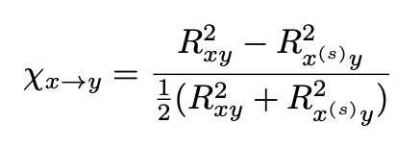
Temporal Autoencoders for Causal Inference
Josuan Calderon & Gordon Berman, 2024
Dual encoders → shared latent space → future prediction
Behavior and MeA signals processed jointly
Approach:
Two-headed predictive autoencoder that predicts the future of one variable (X) from the past of X and Y and another that predicts the future of X from the pasts of X and a randomized version of Y
Quantify gain in predictive power with:
Notes:
If timing is import if we shuffle the meaning still has prestn.
Recently Josan and Gordon came out with a method for doing exactly this! So we'll be using this technique to measure causality in our data.
They made contributions which we'll be using...
An architecture for the model and a metric for explicityly measuring one's gain predictive power.
The machine learning method is composed of two different networks: one takes in the pasts of X and Y and tries to predict the future of Y, and the other takes in the past of Y and a shuffled version of X and tries to predict the future of Y. If the network that has the real time series of X does better, we say that it’s an interaction
We then test the other way (replace all the Xs with Ys and Ys with Xs in the above sentence), and this tells us is both are interacting with each other, one with the other, neither, and the relative strength of the interactions
I can give details on the neural network if useful, but I figured that it wouldn’t be worth going into in this short of a talk, and I will be there if people have questions
We’ve shown that it works on a variety of systems with known answers, including one on the next page

Slide 32
Autoencoder parameters
Shift = 2
Prediction
Window Length = 6
Sequence Length = 4
Lag = 2

Slide 33
Autoencoder parameters
Shift = 2
Prediction
Window Length = 6

Slide 34
What happens if parameter are wrong
Model predicts across unrealistic timescales (e.g., neuron firing → behavior 20 min later)
False causal links may appear
Important dynamics may be missed
(too short sequence/lag)
Too big shift → Underestimate causality or miss it completely (false negatives)
Too small shift → Overestimate causality (false positives)
Notes:
Trying to balance sensory and motor. There is a vast parameter space and many choices can be made. And this is the choice we made. Bias towards motor or biased towards sensory.
neuron firing rn doesn’t effect abehavior 20min from now and these parametes are important and needs to be done correctly

Slide 35
Parameter Optimization
Sweep A
Controls how much history the model looks at (Sequence + Lag)
The goal here for me was to balance sensory and motor interaction
There is a vast parameter space, and many choices can be made and this is the choice I made for my project. For example, we can set the goal to be bias towards either motor/sensory.
Sweep B
Controls how far ahead the model predicts (Shift)
Notes:
Trying to balance sensory and motor. There is a vast parameter space and many choices can be made. And this is the choice we made. Bias towards motor or biased towards sensory.

Slide 36
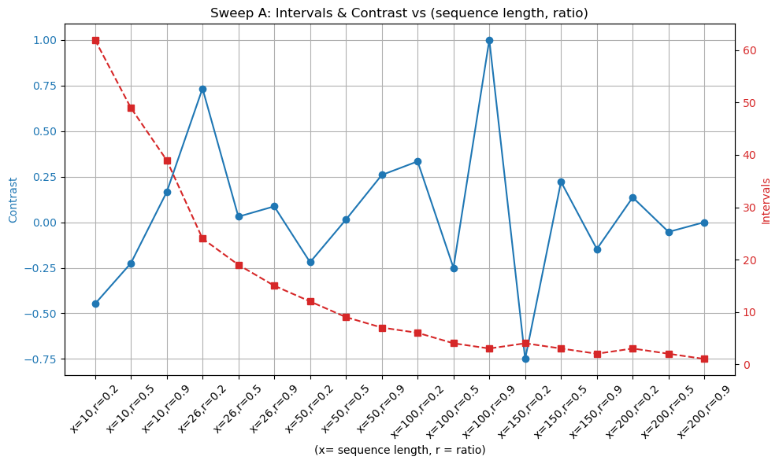
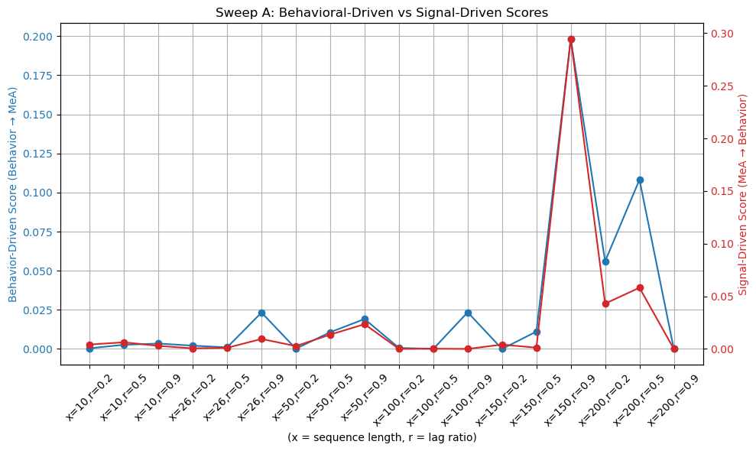
Sweep A (Optimizing Sequence Length and Lag Ratio)
Fixed Parameter: bootstraps_samples = 100, epochs = 20, batch_size = 150, shift = 25
SeqLen (x) | Ratio | Lag | WindowLen | Contrast Ratio
26 | 0.2 | 5 | 31 | 0.733
26 | 0.5 | 13 | 39 | 0.030
26 | 0.9 | 23 | 49 | 0.087
50 | 0.2 | 10 | 60 | -0.220
50 | 0.5 | 25 | 75 | 0.014
50 | 0.9 | 45 | 95 | 0.259
100 | 0.2 | 20 | 120 | 0.333
100 | 0.5 | 50 | 150 | -0.250
100 | 0.9 | 90 | 190 | 1.000
200 | 0.2 | 40 | 240 | 0.136
200 | 0.5 | 100 | 300 | -0.053
200 | 0.9 | 180 | 380 | 0.0

Slide 37
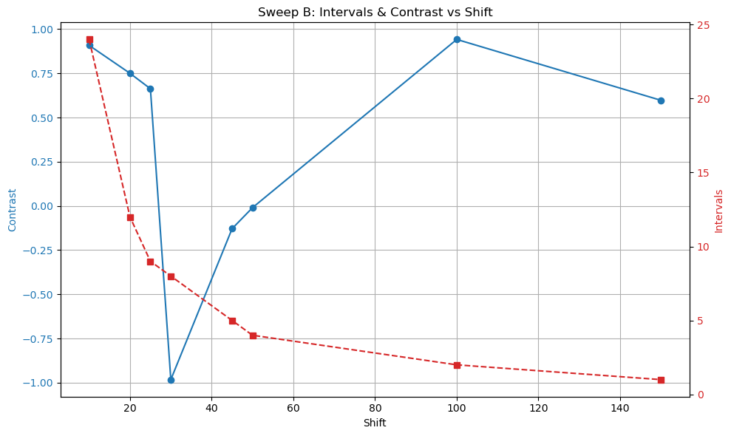
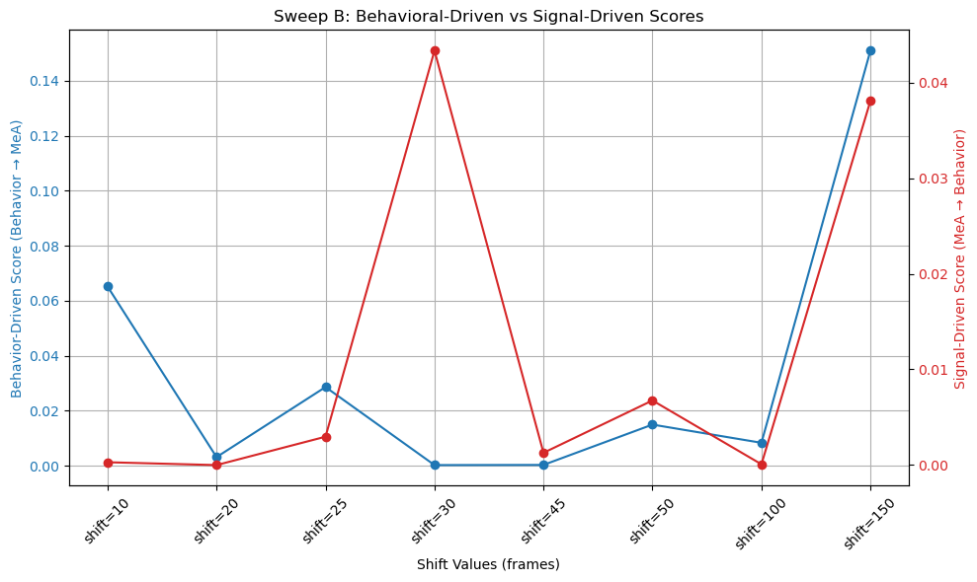
Sweep B (Optimizing Shift)
Fixed Parameter: bootstraps_samples = 100, epochs = 20, batch_size = 150, seq_length = 50, lag = 25, window_length = 75
Shift | Contrast Ratio
10 | 0.908
20 | 0.750
25 | 0.663
30 | -0.983
45 | -0.129
50 | -0.010
100 | 0.942
150 | 0.597

Slide 38
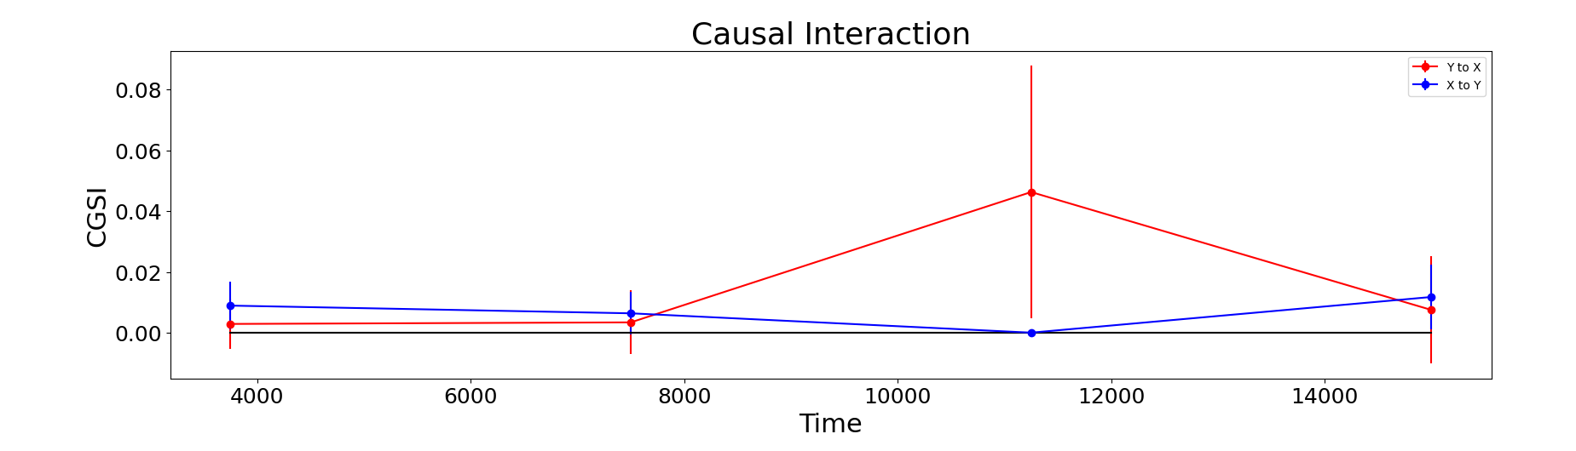
AAV3 Optimized Causal Interaction Score Result
Need for Multi-Experiment Validation:
To lower error bars and to get more intervals

Slide 39
Conclusion
Ensured biologically realistic timescales (Shift and Lag selection)
Avoided making the model predict behavior too far in the future or too soon (prevented meaningless causal links).
Chose parameters that yielded more intervals
More intervals indicate richer and stronger interactions between behavior and neural activity.
Selected parameters with smaller error bars
Smaller error bars mean more reliable and stable causality estimates.
Preferred balanced datasets
Avoided setups that were biased too heavily towards sensory or motor (ensured fair and representative causal detection).
Notes:
How would TACI would do it?
This is the way I would use it .. Be ready to answer.
For this part I need to tie it back to the the beginning anf

Slide 40
Big take away
Behavior drives brain activity dynamically during social encounters, and flexible deep learning models like TACI are essential to uncovering this evolving causality.
Notes:
Whats one thing I want each slide to be higlited

Slide 41
Future Directions
Multi-Region Causality
Study MeA and Aromatase neuron causality
Sex Differences
Compare male vs female causal graphs
Behavioral Categories
Build categorical causal maps: aggression, grooming, freezing, etc.
Notes:
How would TACI would do it?
This is the way I would use it .. Be ready to answer.

